Slide 1
ONLINE VOTING SYSTEM
CS522
Software Quality Assurance and Test Automation
Ruchir Kute
Mansi Rathore
Aparna Nagarajan
Sumandeep Kaur

Slide 2
CONTENTS
Problem Definition/Description
Project Screens
Animated Project Flow
Control Flow Graph
Algorithm
Source Code & Enhanced Code
Junit Test Case to Vote
Cause – Effect Graph
Decision Table
Test Cases – Registration Page
Performance Metrics
Conditions for ECP & BVA
Equivalence Class Partitioning
Boundary Value Analysis
Exit Criteria
Performance Graph

Slide 3
Problem Definition
"Online Voting System" is a simple web-based online voting system that will help to answer a common question of what to include in the course syllabus for any subject.
It will help faculty members to study which Automation Tool student prefers the most and for which tool there is a high demand in today’s competitive market by taking a quick online poll.

Slide 4
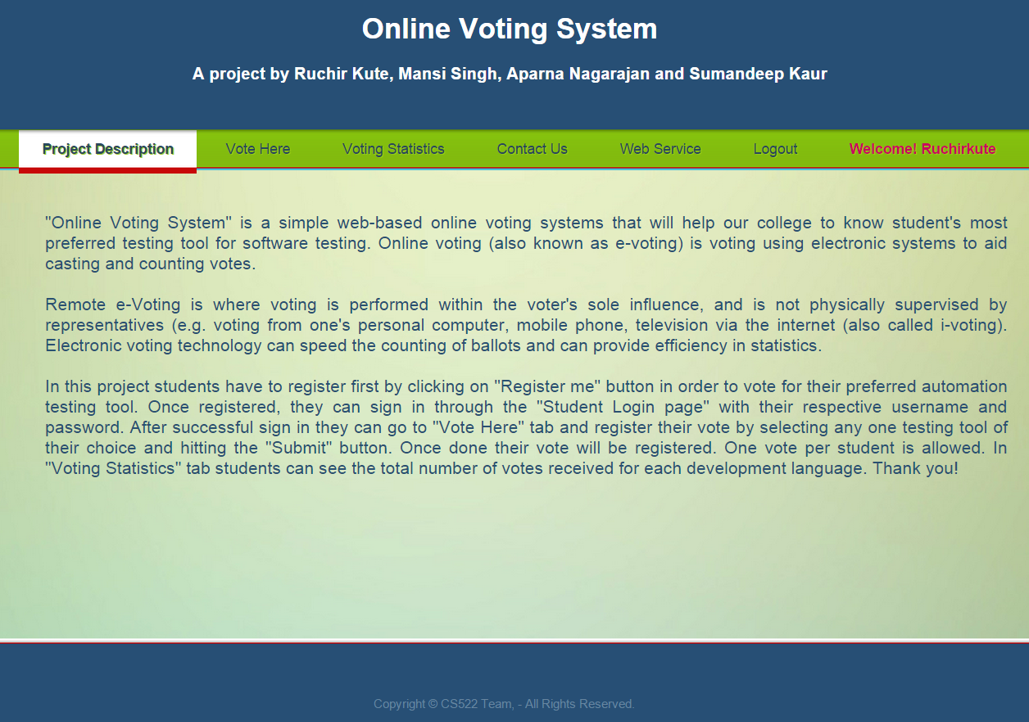
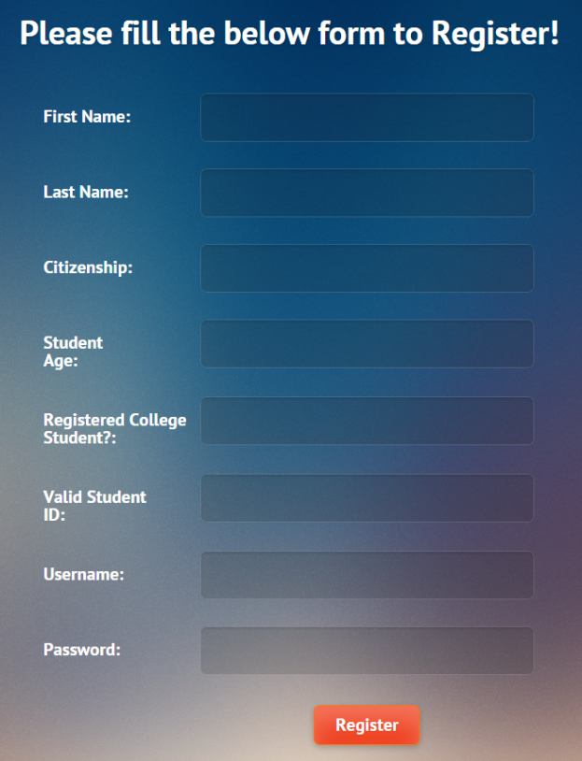
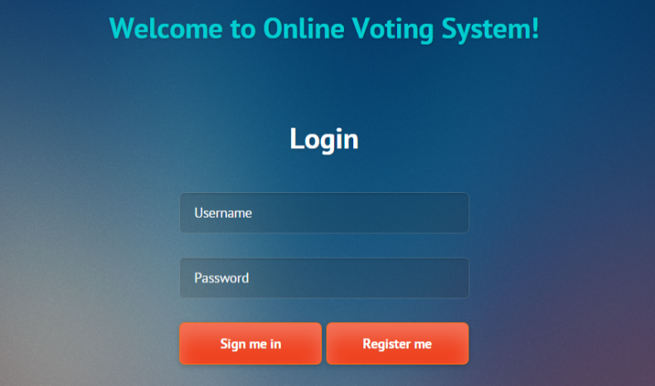
PROJECT SCREENS

Slide 5
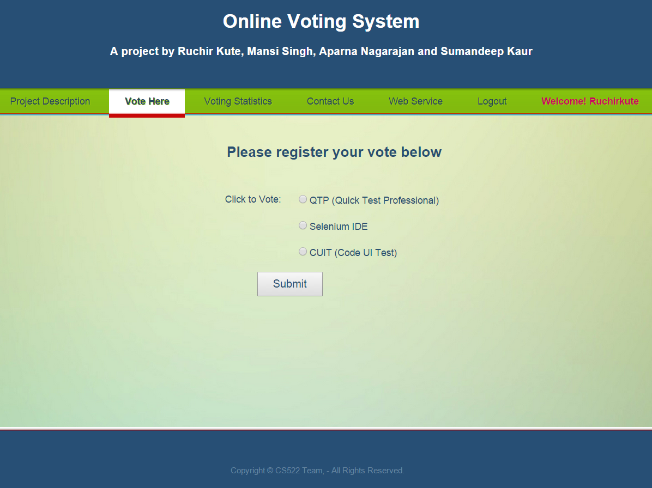
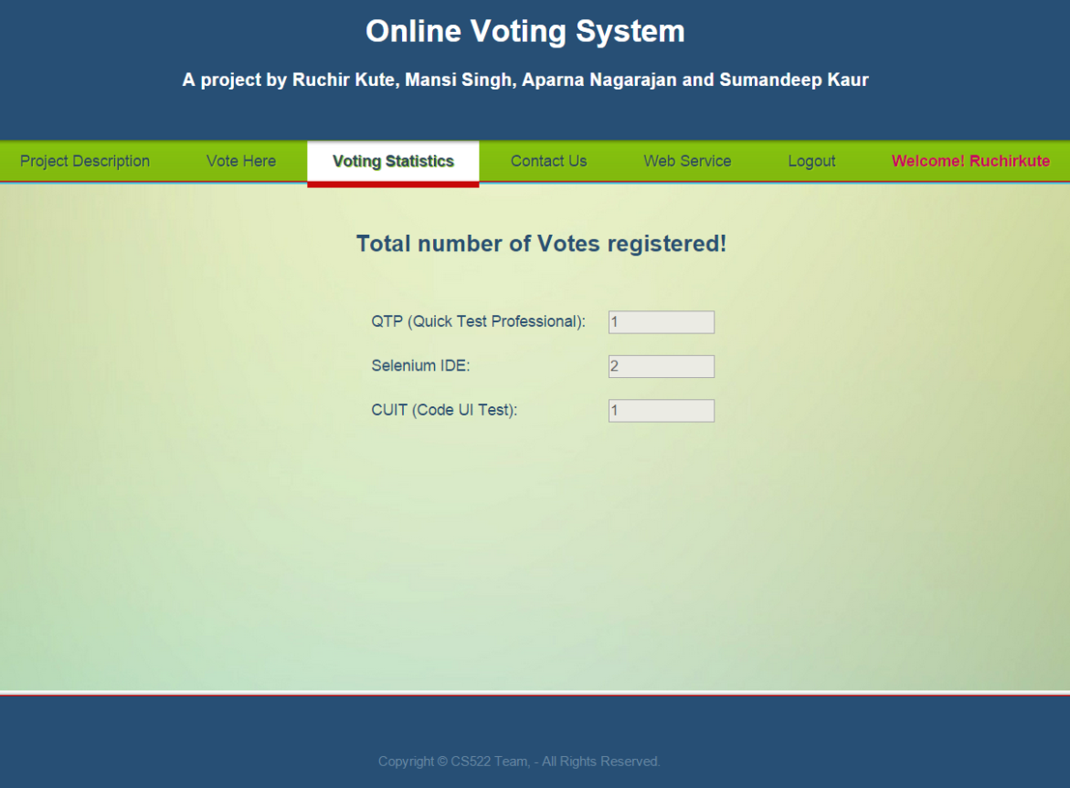
PROJECT SCREENS

Slide 6
Vote Statistics
Vote
Contact Us
Project Description
Logout
Online Voting System
Correct Credentials
Login
Login Fail
Registration Successful
Registration Fail
Registration

Slide 7
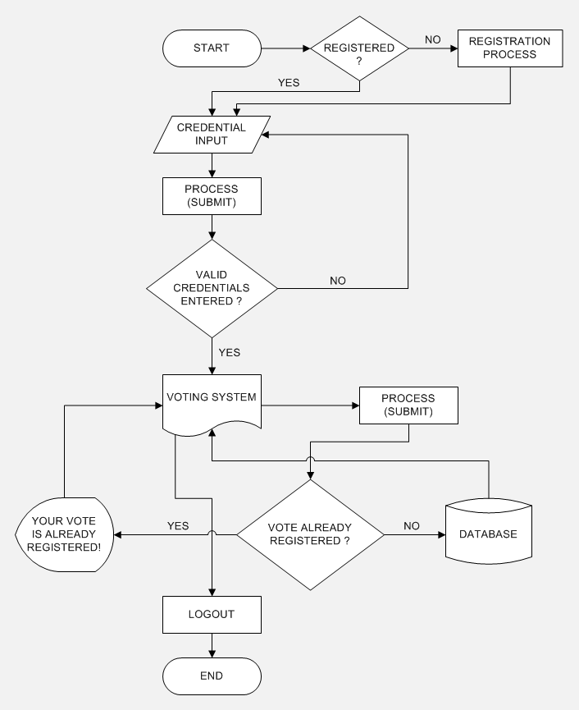
CONTROL FLOW GRAPH

Slide 8
ALGORITHM
Step1: Read User choice;
if(already registered) { goto Step2;}
else { register user;}
end if
Step2: Read Username & Password;
Step3: boolean check( Username & Password );
Step4: if(check) {
Read Vote;
boolean checkVote(Vote);
if(checkVote) { Write: Vote already registered; }
else { Write: Vote to DB; }
end if
}
else { goto Step2; }
end if
Step5: Stop;
Socket.io

Slide 9
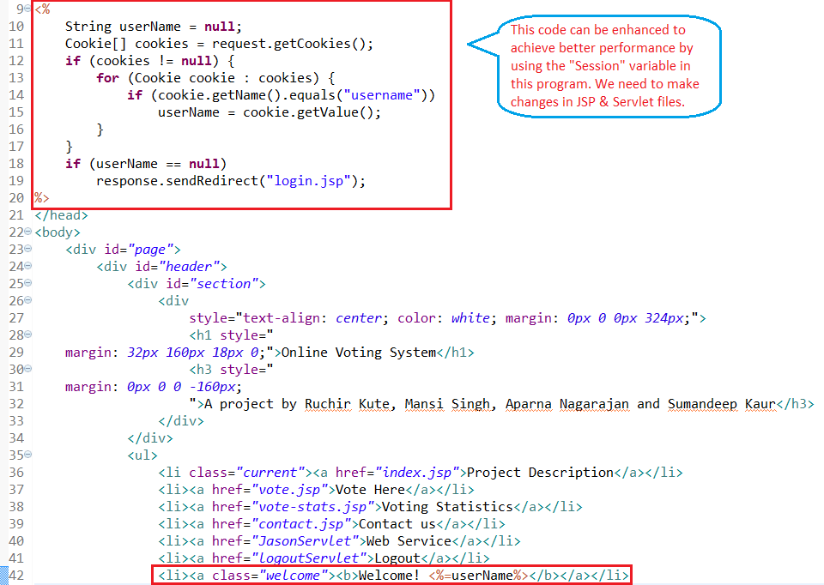
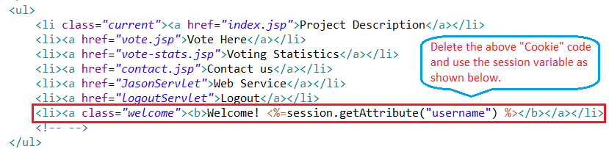
SOURCE CODE & ENHANCED CODE
In JSP pages, to use Session variable we have to use the “getAttribute” method
Also in Login Servlets, we have to use the “setAttribute” method to enhance this code
It gives Better performance
Efficient Code
Less Code & Complexity

Slide 10
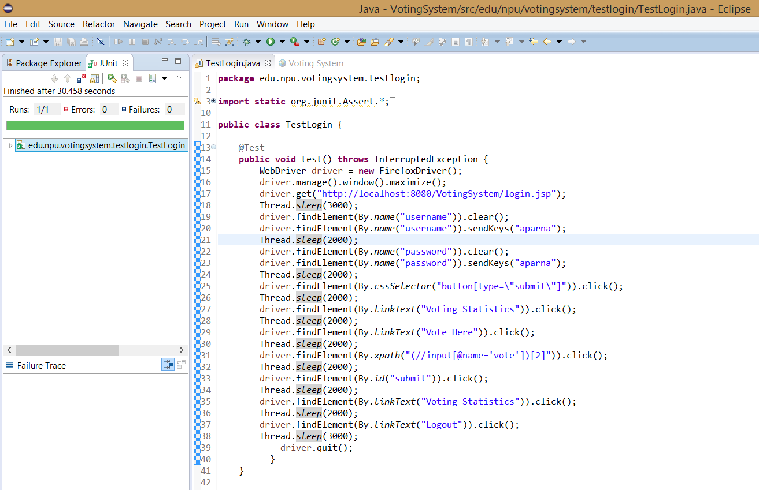
JUnit Test Case to Vote

Slide 11
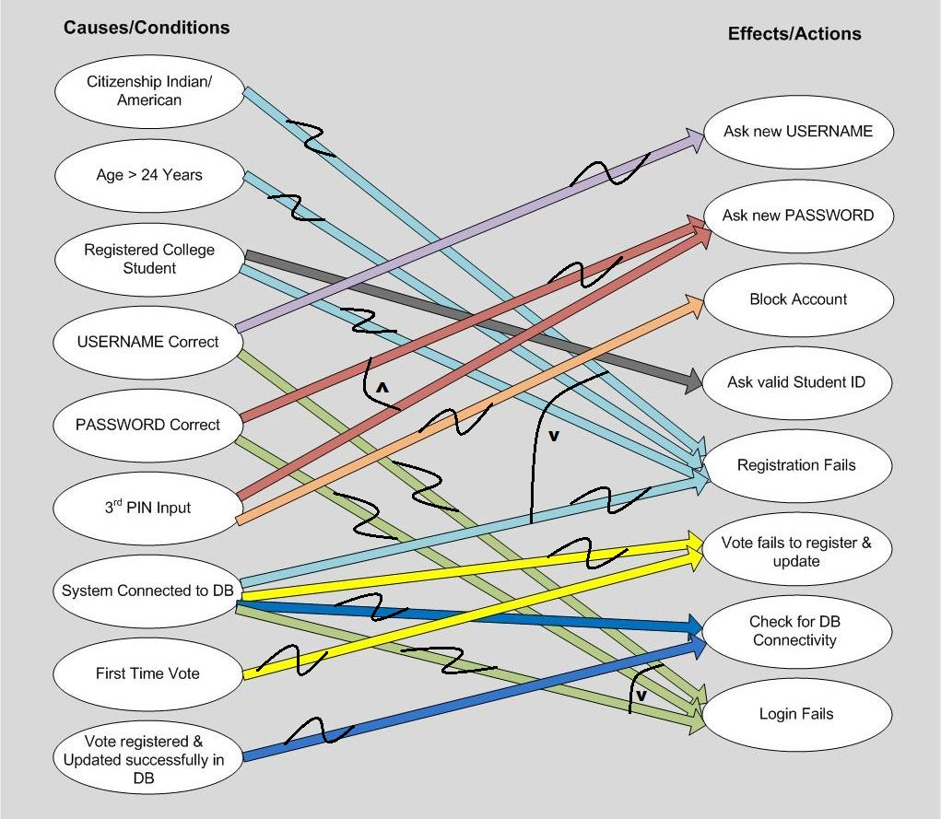
CAUSE – EFFECT GRAPH

Slide 12
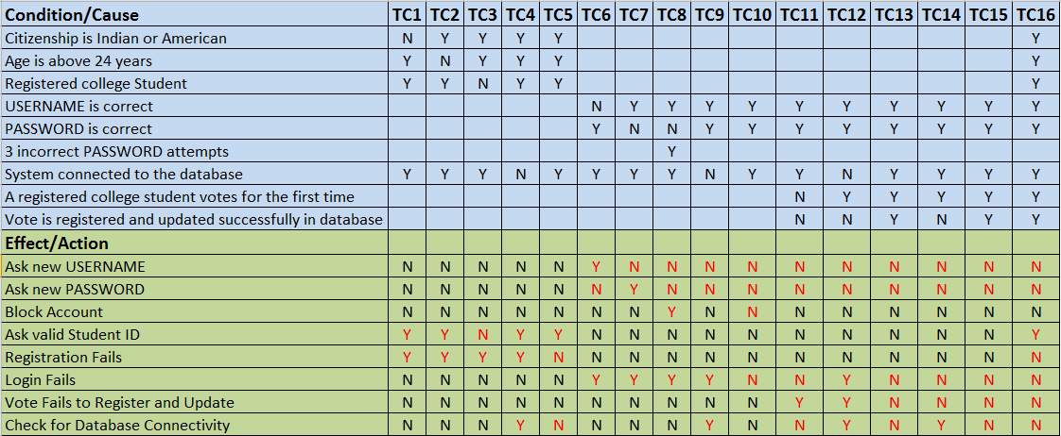
DECISION TABLE

Slide 13
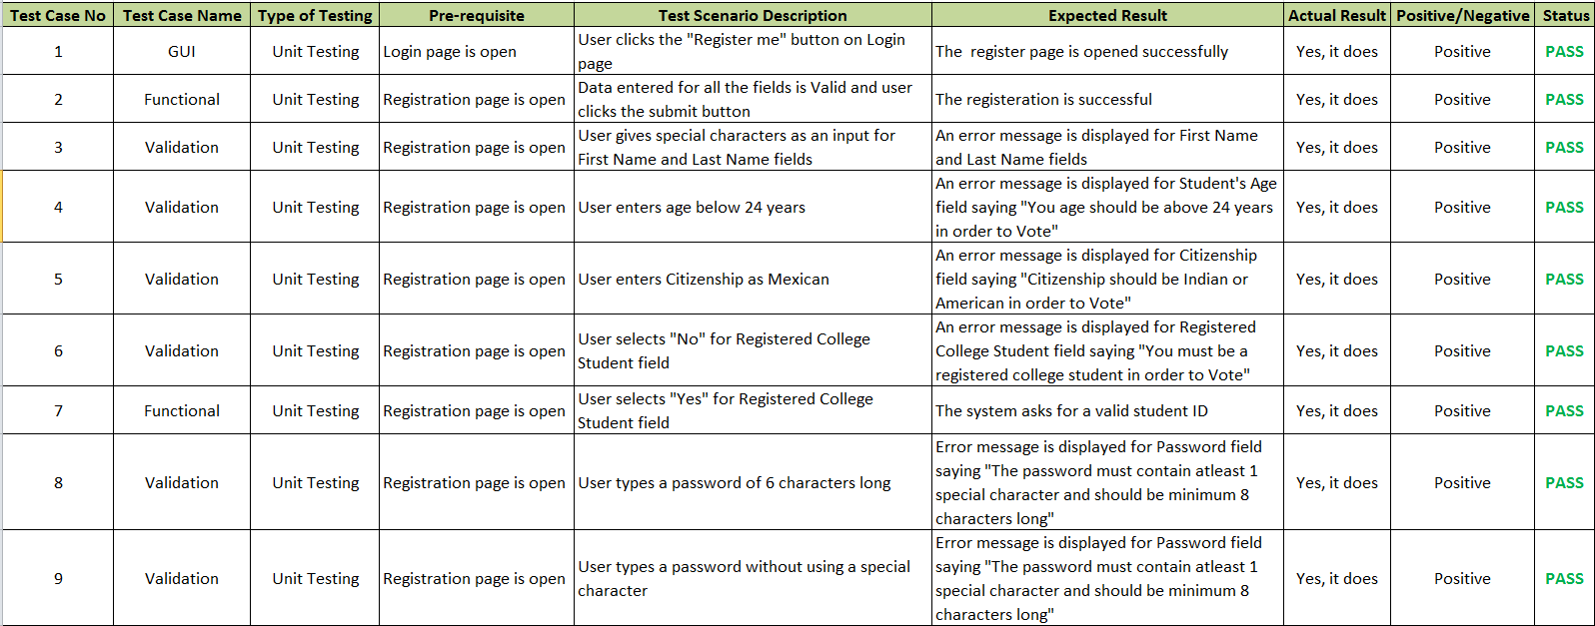
TEST CASES (REGISTRATION PAGE)

Slide 14
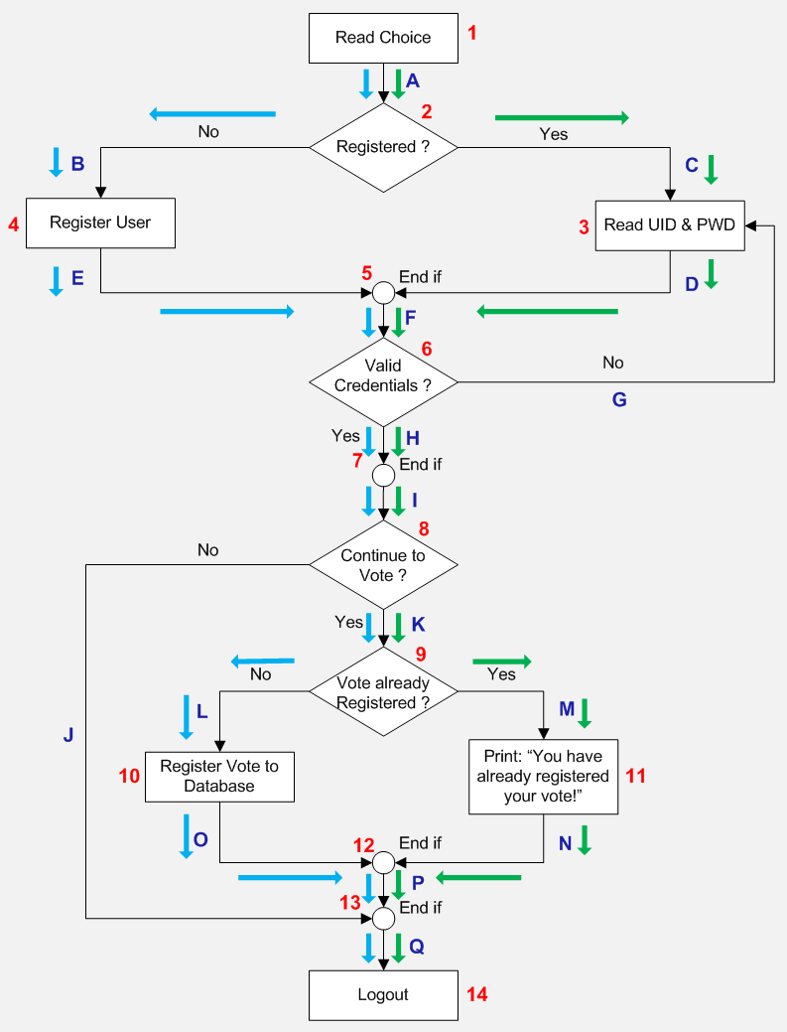
PERFORMANCE METRICS
Statement Coverage (SC): The shortest number of paths (P) which covers all the nodes.
P1 = 1A-2C-3D-5F-6H-7I-8K-9M-11N-12P-13Q-14
P2 = 1A-2B-4E-5F-6H-7I-8K-9L-10O-12P-13Q-14
SC = 2
Branch Coverage (BC): The minimum number of paths (P) which covers all the edges.
P1 = 1A-2B-4E-5F-6H-7I-8K-9L-10O-12P-13Q-14
P2 = 1A-2C-3D-5F-6G
P3 = 1A-2C-3D-5F-6H-7I-8J-13Q-14
P4 = 1A-2B-4E-5F-6H-7I-8K-9M-11N-12P-13Q-14
BC = 4
Cyclomatic Complexity:
V(G) = E (Edges) – N (Nodes) +2
V(G) = 17 – 14 + 2 = 5

Slide 15
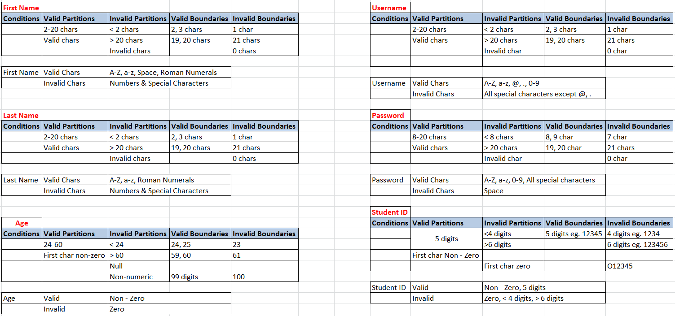
Conditions for ECP & BVA

Slide 16
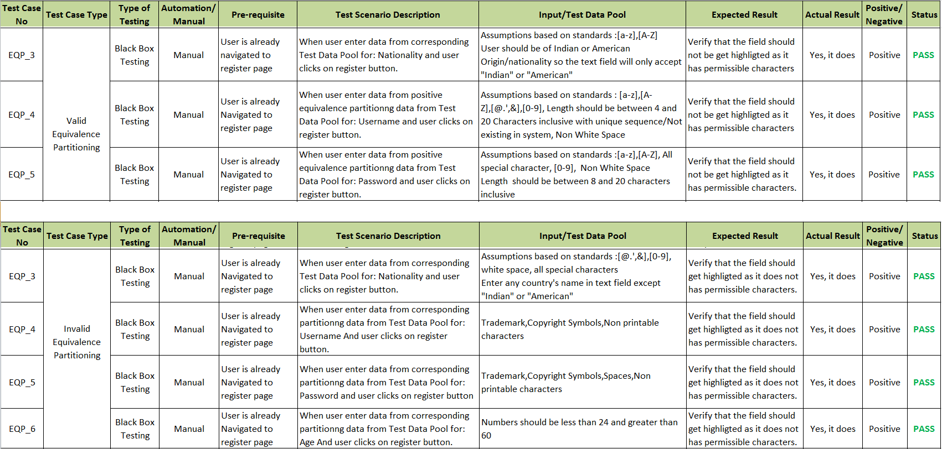
EQUIVALENCE CLASS PARTITIONING (REGISTRATION PAGE)

Slide 17
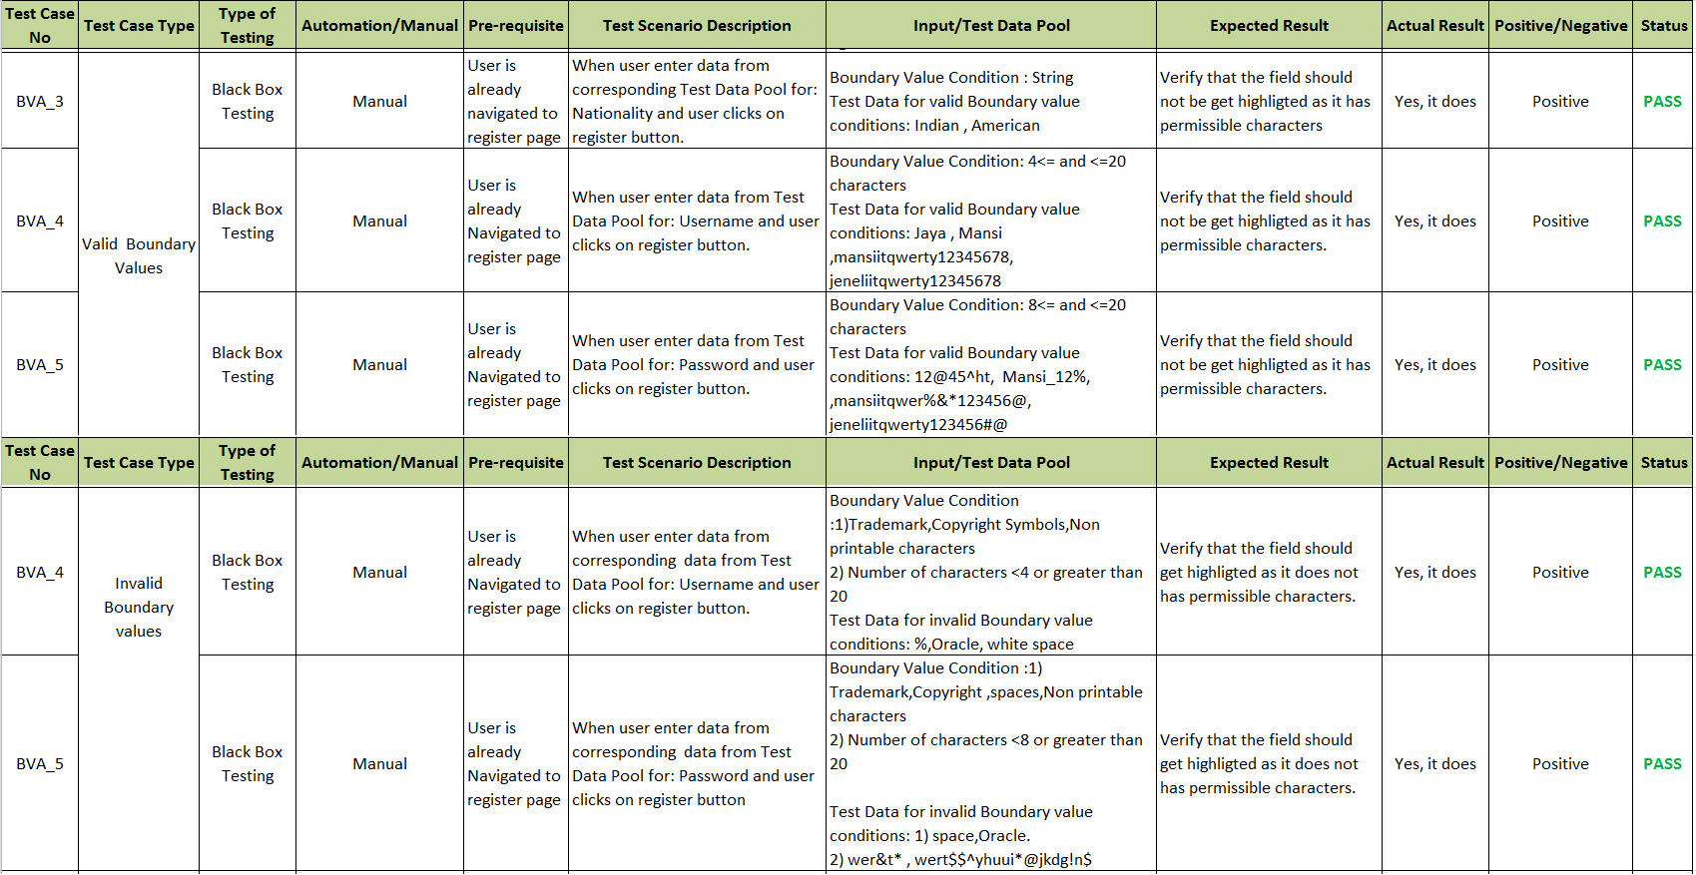
BOUNDARY VALUE ANALYSIS (REGISTRATION PAGE)

Slide 18
EXIT CRITERIA
Test Coverage = Number of Test Cases Passed/Total Number of Test Cases * 100
Test Coverage (First Phase) = 22/45* 100 = 48%
Test Coverage (Final Phase) = 41/45* 100 = 91%

Slide 19
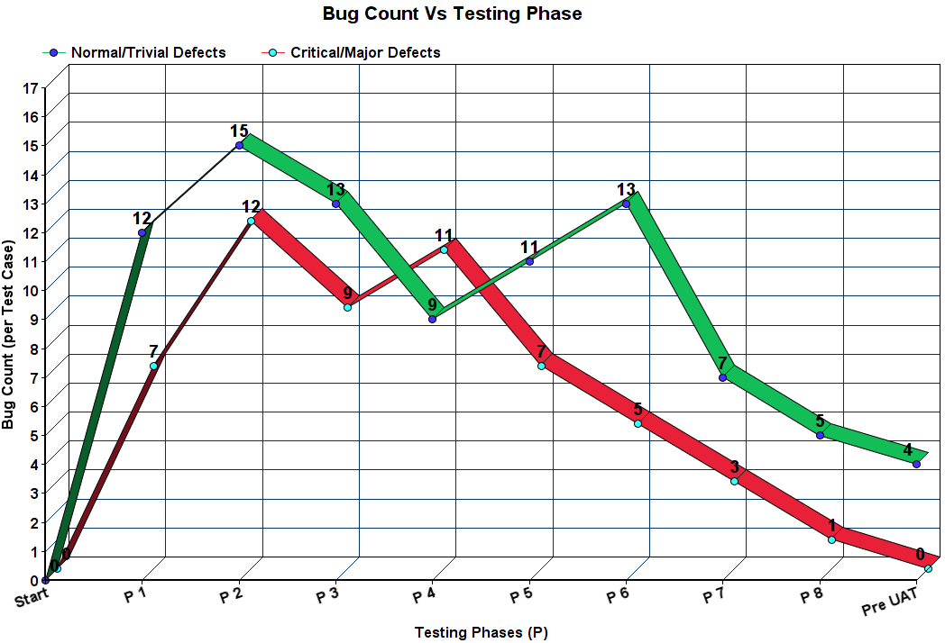
PERFORMANCE GRAPH

Slide 20
Thank you ☺

